Slide 1
Overview of UK Visa Options for International Students
8 June 2022

Slide 2
Introduction
Employment and Immigration solicitors
Ward Hadaway has offices in Manchester, Leeds and Newcastle
Assist visa applicants in the UK and overseas with obtaining visas for the UK
Assist employers with recruiting and sponsoring individuals for visas
but does not cover all options or all relevant information

Slide 3
THE GRADUATE ROUTE

Slide 4
The Graduate Route
New graduate immigration route launched on 1 July 2021
Successful applicants can stay in the UK to work (or look for work)
Eligibility:
Valid Student or Tier 4 visa
Successfully completed a course at undergraduate level (or above) or a ‘relevant qualification’
Studied at an approved UK higher education provider
Students should complete the ‘relevant period’ of their course inside the UK (subject to the Covid-19 concessions)

Slide 5
The Graduate Route
No sponsor required
No job offer required
Will be able to work in a role at any skill level, be self-employed or undertake voluntary work for up to 2 years (3 years for PhD students)
Will not lead to settlement and cannot be extended

Slide 6
The Graduate Route: Covid Concessions
Where distance learning took place overseas between 24 January 2020 and 30 June 2022, this will not prevent the applicant meeting the 'study in the UK' requirements if:
they began a course of 12 months or less prior to 21 June 2021 and entered the UK on or before 27 September 2021 with permission as a Student; or
they began a course of 12 months or less between 21 June 2021 and 30 June 2022 and entered the UK on or before 30 June 2022 with permission as a Student.
Distance learning between 24 January 2020 and 30 June 2022, on a course of study lasting longer than 12 months, whilst the applicant held permission as a Student, will not prevent the applicant from meeting the 'study in the UK' requirements.

Slide 7
The Graduate Route: Practicalities
Applications must be made online from inside the UK
Applicants will have to complete identity, criminality and security checks
An application fee of £715 and Immigration Health Surcharge of £624 (per year) will need to be paid upfront
No maintenance requirement or proof of English Language requirement
Strict rules regarding dependants

Slide 8
The Graduate Route: Conditions of Grant
What you can do:
You are allowed to take up extra study (certain exceptions).
Work (including self-employment and voluntary work) is permitted.
You can travel out of, and re-enter, the UK.
What you can’t do:
You cannot access public funds.
Study with a student sponsor on a course which would meet the requirements of a Student visa.
The route cannot be extended and does not count towards settlement.

Slide 9
VISA ROUTES – SETTING UP A BUSINESS

Slide 10
Visas for Students Wanting to Start Their Own Business in the UK
Start-up Visa
For applicants who want to start up a business in the UK
This has replaced the previous Tier 1 (Graduate Entrepreneur) visa and is available to a wider pool of migrants (not just graduates)
Applicants must be endorsed by either a:
UK higher education institution; or
a business organisation with a history of supporting UK entrepreneurs.
You must be able to show that your business is:
A new idea;
Innovative; and
Viable.

Slide 11
Start-up Visa
Eligibility:
Received endorsement;
£1,270 held in bank account for 28 days prior to application (not applicable if you have been in the UK for more than 12 months); and
Meet English language requirement.
You can work for your business and have another job.
Visa issued for 2 years but does not count towards settlement.
You cannot extend this visa but you can switch into the Innovator category.

Slide 12
Innovator Visa
Can switch from Tier 4/Student visa to Innovator visa, but most graduates apply for Start-up visa then switch into the Innovator visa.
If you switch from the Start-up visa into the Innovator Visa:
You can stay for a further 3 years in the UK, and you can extend this visa as many times as you wish;
You can apply for settlement after 3 years;
But you cannot have another job and must only work for your business.
If you are running the same business as you did under your Start-up visa you do not need £50,000 investment monies, however your business will need to receive endorsement again.

Slide 13
Global Talent Visa
For highly skilled migrants who work in a qualifying field and have been endorsed by a Designated Competent Body as:
a recognised leader (exceptional talent);
an emerging leader (exceptional promise);
under the UK Research and Innovation endorsed funder option.
Very flexible visa type – allows you to work, be self-employed or study.
Visa granted for up to 5 years at a time, can be extended and can lead to settlement after 3 or 5 years, depending on the endorsement route you are applying for.

Slide 14
VISA ROUTES - EMPLOYMENT

Slide 15
Skilled Worker Visa (previously Tier 2 General visa)
An applicant has to receive a minimum of 70 points which they can achieve through:
Being sponsored (offered a job by a sponsor)
The role being skilled
Meeting the minimum salary
Meeting the English language requirement
Requirement to be sponsored - who can sponsor me for this visa?
UK based employer registered with UK Visas & Immigration
Over 30,000 registered sponsors
Search for prospective employer on register of licensed sponsors

Slide 16
Skilled Worker
What jobs are eligible for sponsorship?
Need to look at skill level and salary:
Minimum skill level – RQF Level 3.
Minimum salary – new entrant rate applies to students (and those who held a Student Visa up to two years before the application).
From December 2020 this is £20,480 per year or 70% of “going rate” in SOC code, whichever is higher.
Standard Occupation Classification (SOC Codes).

Slide 17
Skilled Worker: Salary

Slide 18
Skilled Worker
List of skilled occupations can be found here: https://www.gov.uk/government/publications/skilled-worker-visa-eligible-occupations/skilled-worker-visa-eligible-occupations-and-codes
List of minimum salary rates can be found here: https://www.gov.uk/guidance/immigration-rules/immigration-rules-appendix-skilled-occupations
ONS Occupation Coding Tool can be found here: https://onsdigital.github.io/dp-classification-tools/standard-occupational-classification/ONS_SOC_occupation_coding_tool.html

Slide 19
Skilled Worker
Other eligibility:
Meet English language requirement;
Valid sponsorship;
£1,270 held in bank account for 28 days prior to application (unless sponsor is certifying);
Criminal record certificate.
Allows you to work for your sponsor only.
Can lead to settlement in the UK.
Current cost for a Skilled Worker visa is £719 for a three year visa and £1,423 for a visa for more than 3 years, plus the Immigration Health Surcharge (currently £624 a year).
If your job is on the shortage occupation list, the fee is £479 for 3 years and £928 for more than 3 years.

Slide 20
Benefits of a Skilled Worker Visa
No need to advertise the role to give non-visa holders the opportunity to apply
Range of roles suitable for sponsorship has been extended significantly
Able to sponsor student on a lower salary for up to 2 years after student visa expires
No Immigration Skills Charge payable if switching

Slide 21
Applying For A Sponsor Licence
Employers must hold a valid sponsor licence before sponsoring a worker for a Skilled Worker visa
Employers are required to complete an application form and provide supporting documentation
Applications can take 8 weeks to process
Recent trend in UKVI requesting significant amounts of information – crucial to plan ahead

Slide 22
Timeline for recruitment and sponsorship: applying inside the UK
Sponsor licence applications can take 8 weeks to process but can take 3 – 4 weeks in straightforward cases
If employer holds a sponsor licence and has a CoS, a prospective employee could feasibly be recruited as little as 2 weeks
If a Skilled Worker visa application is submitted on or before current visa expires, can remain living and working in the UK whilst the application is being decided
Application processing times from inside UK are c. 8 weeks for Skilled Worker visa

Slide 23
Timeline for recruitment and sponsorship: applying outside UK
Process for applying from outside the UK is the same as applying from inside the UK
Need to leave UK before current visa expires and apply from home country
Ideal timeline for applying for sponsor licence to visa application – 12 weeks
Application processing times from outside UK are c. 3 weeks for Skilled Worker visa

Slide 24
INTERNSHIPS

Slide 25
Temporary Worker: Government Authorised Exchange Visa
Overseas migrants who wish to come to the UK on a temporary basis through a government approved scheme.
To gain work experience, receive training, carry out research or a fellowship or participate in an Overseas Government Language Programme.
Need a sponsor.
Typical sponsors: Government departments/agencies, education institutions for research posts, approved organisations holding sponsor licences.

Slide 26
Government Authorised Exchange visa
Visa holders can study or work in the UK on a temporary basis
Must have £1,270 held in a bank account for 28 days prior to application (unless exempt)
Can switch to this visa from inside the UK before Tier 4 visa or Student visa expires
Visa granted for up to 2 years

Slide 27
OTHER VISA TYPES

Slide 28
Youth Mobility Scheme
Allows you to live and work in the UK for up to 2 years.
Eligibility:
Aged 18-30;
From Australia, Canada, Monaco, New Zealand, San Marino, Iceland or are a British overseas citizen/national;
You must be selected in the Youth Mobility Scheme ballot before you can apply for your visa if you’re from: Hong Kong, Japan, South Korea or Taiwan.
Must have £2,530 in savings for 28 consecutive days before applications.
Cannot apply if you have:
Children living with you or have financial responsibility for children
Already been in UK under the scheme

Slide 29
Youth Mobility Scheme
Visa allows you to study or work, be self-employed and set up a company
Must apply from outside the UK
Granted for up to 2 years, cannot be extended and cannot lead to settlement
Cannot switch to another visa from within the UK

Slide 30
NEW VISA ROUTES

Slide 31
Global Business Mobility Routes
5 new routes launched from 11 April 2022 aimed at overseas businesses wishing to establish a presence in or transfer staff to the UK:
Senior or Specialist Worker;
Graduate Trainee;
UK Expansion Worker;
Service Supplier; and
Secondment Worker.
Dependent partners and children can apply
Do not lead to settlement

Slide 32
QUESTIONS

Slide 33
Useful Links
Start-Up – https://www.gov.uk/start-up-visa
Innovator – https://www.gov.uk/innovator-visa
Skilled Worker - https://www.gov.uk/skilled-worker-visa
Skilled Worker SOC Codes - https://www.gov.uk/government/publications/skilled-worker-visa-eligible-occupations/skilled-worker-visa-eligible-occupations-and-codes
Register of licensed sponsors - https://www.gov.uk/government/publications/register-of-licensed-sponsors-workers
Tier 5 (Youth Mobility Scheme) - https://www.gov.uk/tier-5-youth-mobility
Covid guidance - https://www.gov.uk/guidance/coronavirus-covid-19-advice-for-uk-visa-applicants-and-temporary-uk-residents
Global Mobility Route guidance - https://assets.publishing.service.gov.uk/government/uploads/system/uploads/attachment_data/file/1067926/Global_Business_Mobility_routes_guidance.pdf

Slide 34
https://www.wardhadaway.com/visa-guidelines/

Slide 35
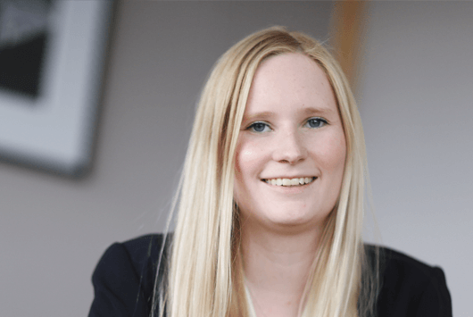
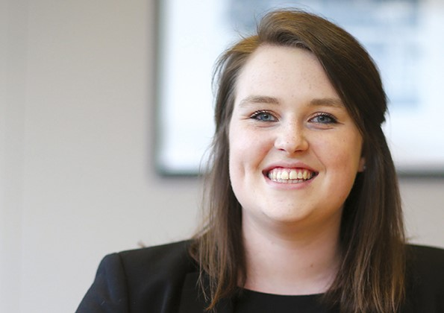
Claire Turner
Solicitor |
E: claire.turner@wardhadaway.com

