Slide 1




An Explanatory Guide to
The Nagoya Protocol
June 2016
Notes:
COVER SLIDE

Slide 2
An Introduction to the Nagoya Protocol
Key Points of the Protocol
Nagoya in the UK
Access and Benefits Sharing Clearing House (ABS-CH)
IRCC – Seek, keep and transfer procedure
The effect of the Nagoya Protocol on patents
Actions for the University of Salford
Due Diligence
Notes:
List of slide headings

Slide 3

An Introduction to the Nagoya Protocol
12 October 2014 – The Nagoya Protocol enters into force in the EU (EU Reg. 511/2014)
09 November 2015 – Rules regarding the registration of the collection of genetic resources, monitoring user compliance and best practices enters into force (EU Reg. 2015/1866)
The Nagoya Protocol is a supplementary agreement to the Convention on Biological Diversity (CBD).
Aim of the Protocol:
To provide a legal framework for the implementation of one of the three objectives of the CBD: the fair and equitable sharing of benefits arising out of the utilization of genetic resources, thereby contributing to the conservation and sustainable use of biodiversity.
Prevention of bio-piracy
  The commercial or academic development of genetic resources by a country or organisation without obtaining prior consent from, or providing fair compensation tom the people or country where the resource was first discovered.

Slide 4

The Nagoya Protocol relates to the utilisation of genetic resources and traditional knowledge associated with genetic resources. A genetic resource is defined as any non-human genetic resource. ‘Utilisation’ refers to research and development on the genetic and/or biochemical composition of genetic resources. The Protocol, therefore, relates to both commercial and academic research.
The Nagoya Protocol gives provider countries the rights to control access to genetic resources found within their jurisdiction.
  Two categories of provider country:
    An originating country where the genetic resource exists in situ, i.e. genetic resource exists in its natural habitat.
    An originating country where the genetic resource exists ex situ, i.e. genetic resource exists outside of its natural habitat. A country falling within this category must have obtained the genetic resource from an originating country under the CBD.

Slide 5
The burden is placed on the user (researcher) to show that the genetic resource on which research is being conducted was legally obtained in accordance with the Nagoya Protocol.
In order to do this, a user must:
  Obtain the prior informed consent (PIC) of a providing country (i.e. the country where the genetic resource exists in situ) before access to a genetic resource is permitted
  Provide a fair and equitable share of the benefits which arise from utilisation of the genetic resources. Such sharing shall be upon mutually agreed terms (MATs). The benefits can be either commercial (e.g. monetary) or non-commercial, including the sharing of data or a transfer of intellectual property rights.
The effect of the Nagoya Protocol is to make it illegal to perform research and development on a genetic resource that has not been accessed in accordance with the Nagoya Protocol.
For the Nagoya Protocol to apply, the genetic resources must be accessed by an EU member state after entry into force of the Nagoya Protocol for the EU, i.e. on or after 12 October 2014.

Slide 6

All states party to the Protocol must appoint a Competent National Authority (CNA).
- An executive agency for ensuring “fair and accurate measurements are available and used for transactions”
- Responsible for enforcing the Nagoya Protocol, including; monitoring compliance, inspecting due diligence and raising awareness of the Nagoya Protocol.
The National Measurement and Regulation Office (NMRO) appointed as the ‘Competent Authority’ in the UK.
Department for Environment, Food and Rural Affairs (DEFRA) will be the National Focal Point in the UK.
- A resource for answering questions, explaining information regarding the Protocol etc.
Penalties for non-compliance
Made at the discretion of each EU member state – different consequences in different member states
In the UK – DEFRA have indicated a fine up to £250,000 and a maximum of two years in prison for severe cases of wilful non-compliance

Slide 7
ABS-CH is an international body which provides a platform for exchanging information concerning a provider country’s legislative measures, details of CNAs etc., and is a key tool for facilitating the implementation of the Nagoya Protocol.
Each provider country informs the ABS-CH of its national provisions with regards to access and benefits sharing (ABS) information.
The role of the ABS-CH is to provide:
a database comprising the access and benefit sharing requirements of each provider country
  including the provider country’s national provisions and legislation, contact details of the CNA within the provider country, and internally recognised certificates of compliance (IRCC)
the legislative and practical information required by a user to access a genetic resource and associated traditional knowledge from a provider country in accordance with the Nagoya Protocol
A platform between a provider country and a user to discuss mutual terms upon which access to a genetic resource and traditional information can be shared.
An internationally recognised certificate of compliance (IRCC) – evidence that the genetic resource has been accessed in accordance with the Nagoya Protocol.
Notes:
Notes corresponding to bullet points on the slide.
First port of call for a researcher once a desired genetic resource is identified. Establish what needs to be done with respect to the appropriate provider country’s ABS requirements. PROBLEM – PIC and ABS agreements are often required before access to a genetic resource is permitted, however no guarantee that anything useful will be discovered, therefore, time and resource will have been wasted on negotiating an ABS agreement. Highly relevant for pharma industry where useful drug discovery rate is exceptionally low.
How a user is required to proceed with ABS requirements
ABS-CH is designed to streamline what is potentially a very administratively cumbersome procedure (negotiation of MATs).
Ultimately, ABS-CH issue the IRCC which a user can provide as evidence that the genetic resource has been accessed in accordance with the Nagoya Protocol. IRCC comprises information on the MATs established between the provider country and the user. If MATs in IRCC relate only to non-commercial research but subsequently commercialisation appears likely, MATs need to be renegotiated with the provider country (see slide 9).

Slide 8


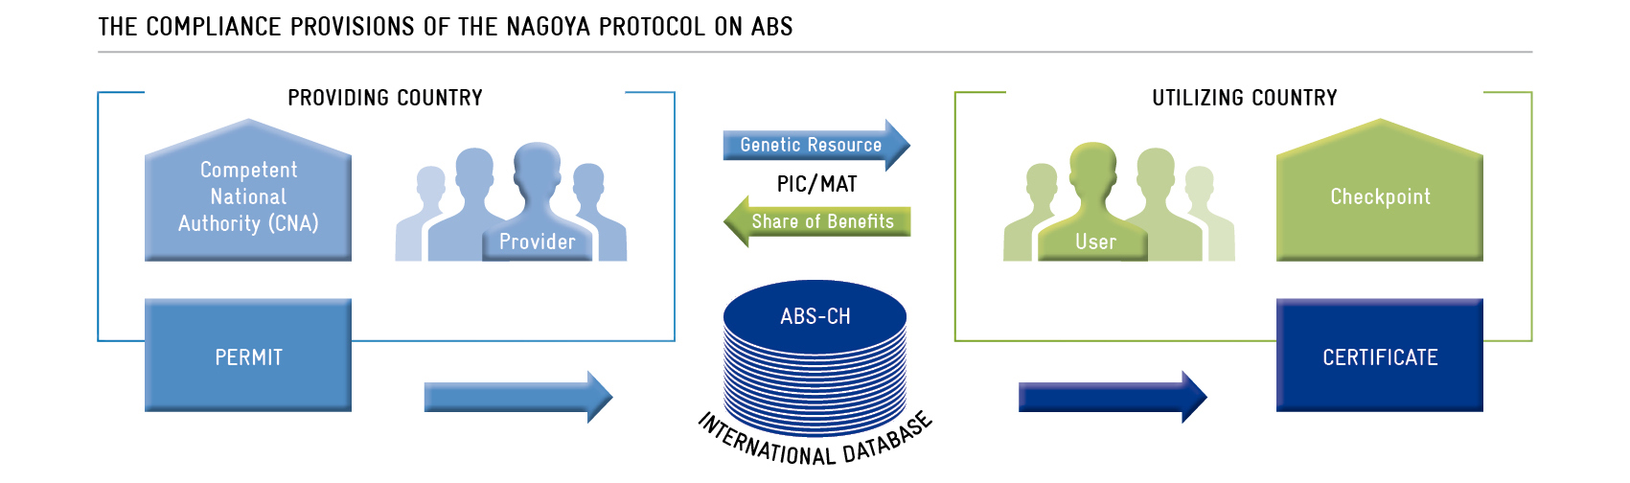
PIC/MAT negotiated between user and Competent National Authority within the provider country – using the ABS-CH as an internet-based platform
Competent National Authority issues a national permit to ABS-CH
ABS-CH issue IRCC to the user as evidence of compliance with the Protocol
Notes:
User contacts ABS-CH for details of how to agree MATs with the provider country. User contacts the competent national authority in the provider country. PIC and MATs negotiated between the user and the competent national authority. In particular, whether use is to be commercial or non-commercial. Details can be made confidential. Non-commercial MATs can be renegotiated at a later date.
The ABS-CH receives a national permit from a provider country giving permission for a user to access a genetic resource (evidence of PIC and MATs). Subsequently, the ABS-CH will issue an IRCC to the user as evidence the genetic resource has been accessed in accordance with the Protocol.
IRCC must be presented to show compliance with the Protocol when certain events are triggered, e.g. receipt of research funding, commercialisation of a product, applying for market approval in the EU.
These details are passed from the user to the ABS-CH, who in turn pass the details to the competent authority within the provider country as a report on the progress of the research and development of their genetic resources. Provider country may now negotiate new MATs if, for example, the initial MATs were only for non-commercial use but the user now wishes to commercialise a product formed as a result of the genetic resource, therefore, commercial-use terms need to be negotiated.

Slide 9
A user is required to seek, keep and transfer the IRCC (or other relevant documents) to subsequent users of the genetic resource as evidence that the genetic resource has been accessed in accordance with the Nagoya Protocol.
Any information not contained within the IRCC which relates to the MATs must also be part of the seek, keep and transfer procedure.
The IRCC also needs to be provided to the ABS-CH when certain ‘trigger events’ occur.
MATs can be renegotiated if original MATs were only for non-commercial use of a genetic resource.
Trigger event, e.g. commercialisation of product
User must present IRCC to ABS-CH
ABS-CH forward IRCC and details of trigger event to CNA
CNA can renegotiate MATs with user
Notes:
If the relevant IRCC is not yet available, information regarding the date and place of access, description of the genetic resource utilised, source of genetic resource and subsequent users, ABS agreements and MATs should be kept in accordance with the seek, keep and transfer procedure.
IRCC must be presented to show compliance with the Protocol when certain events are triggered, e.g. receipt of research funding, commercialisation of a product, applying for market approval in the EU.
These details are passed from the user to the ABS-CH, who in turn pass the details to the competent authority within the provider country as a report on the progress of the research and development of their genetic resources. Provider country may now negotiate new terms to the MAT if, for example, the initial MAT were only for non-commercial use but the user now wishes to commercialise a product formed as a result of the genetic resource, therefore commercial use terms need to be negotiated.

Slide 10

Users (e.g. researchers) are required to exercise due diligence to establish that genetic resources have been accessed in accordance with ABS requirements.
Exercising due diligence will show:
  Prior informed consent (PIC) of a provider country before access to a genetic resource is permitted
  Mutually agreed terms (MATs) have been established
  A fair and equitable sharing of the benefits arising from utilisation of a genetic resource (and the associated traditional knowledge) has been established with the provider country
All recipients of research funding which involves the utilisation of genetic resources and traditional knowledge will be requested by EU Member States to declare due diligence was exercised in accordance with the Nagoya Protocol.
All information relating to access and benefits sharing must be kept by the user for 20 years after the end of the period of utilisation.
Notes:
Problems envisaged by Nagoya:

Slide 11
Supporting due diligence
Two EU provisions to assist Users:
Registered Collections (EU Reg 511/2014, Art. 5) – low burden on the user
  Internet-based register established by the European Commission (EC) comprising sets of collected samples of genetic resources that is accumulated and stored.
  A user obtaining a sample from this register shall be deemed to have exercised due diligence in accordance with EU regulations.
Best Practice Recognition (EU Reg 511/2014, Art. 8) – greater burden on the user
  Associations of users may submit an application to the EC to have a combination of procedures, tools or mechanisms, developed by them, recognised as a best practice in accordance with the Protocol. The application must be supported by evidence and information.
  If an inspection of a user’s procedure shows that it complies with due diligence obligations, a lower frequency of future inspections may result – still a significant burden on the user.
  A register of recognised best practices will be established by the EC.
Notes:
Registered collection – not yet established. To be established by the European Commission (EC). EC will establish and maintain an internet-based register of collections within the EU. The register shall include the references of the collections of genetic resources.
Best Practice Recognition:
Compliance checks may include:
- Examination of the measures taken by a user to fulfil his obligations
- Examination of documentation and records which should demonstrate the users exercise of due diligence
- On-the-spot checks
If deficiencies are noted by the competent national authority, a notice of remedial action or a notice of measures to be implemented will be issued to the user.

Slide 12

Difficult to predict…
Currently, there are no plans to amend the European Patent Convention (EPC) in response to the Nagoya Protocol.
However, the implementation of a proposed policy from the World Intellectual Property Organisation (WIPO) (WIPO/GRTKF/IC/28/4; Art. 3) would require a patent application to disclose:
the origin of genetic resources and/or traditional knowledge,
ABS requirements imposed by the relevant CNA (including PIC), and
if the origin of the genetic resource is unknown, a declaration to that effect.
This may result in the prevention of grant of a patent through lack of sufficiency of disclosure, rather than an explicit lack of compliance with the Nagoya Protocol. This would allow the European Patent Office to ensure patent applicants abide with the provisions of the Nagoya Protocol without the need to amend the EPC.

Slide 13

Researcher receives funding for research
Genetic resource (or its derivative) identified by researcher
Initial planning stage
NMRO (as CNA) provide guidance on PIC and MATs
Researcher registers on ABS-CH website (preferred method)
Notes:
Flow chart of how a researcher at the University of Salford should proceed with abiding by the Nagoya Protocol.

Slide 14
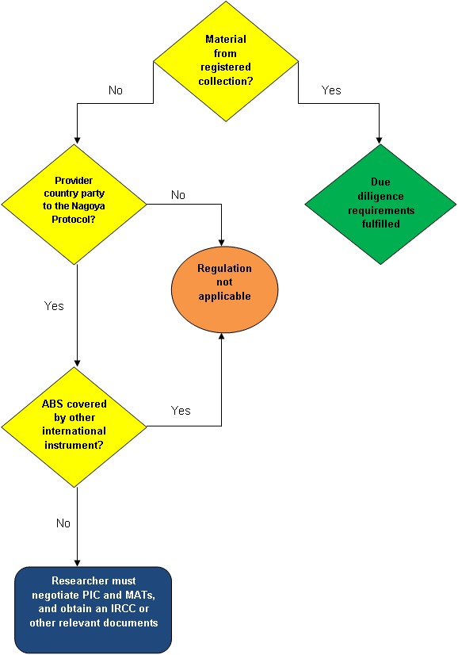
A
Is the Nagoya Protocol applicable to the required genetic resource
A – If the genetic resource is obtained from a registered collection established in accordance with EU Reg Art. 5, requirements relating to due diligence are fulfilled.
B – Significant countries not party to Nagoya are United States of America, China and Canada.
C – Some countries are proposing to implement legal frameworks encompassing the ABS provisions of Nagoya. It is thought these frameworks will be accepted as an alternative to ABS.
B
C
Notes:
A – See also slide 11 (Due Diligence)
B – It is not yet known what impact this will have. For example, if research is carried out on genetic resources by researchers in the US, subsequently the US researchers publish a paper in a scientific journal (traditional knowledge). An EU-based company develops this ‘knowledge’ and adapts the teachings to genetic resources found in the EU. The EU company commercialises a product (possibly including patent protection) ultimately formed as a result of the knowledge gained from the US research. The question is, as the EU is a party to Nagoya, will the EU company be required to show due diligence with regards to genetic resource originally studied by the US researchers?
C – EU Reg 511/2014, Art. 2(2) – This Regulation does not apply to genetic resources for which access and benefit-sharing is governed by specialised international instruments that are consistent with, and do not run counter to the objectives of the Convention and the Nagoya Protocol.
Further details are currently unknown.

Slide 15
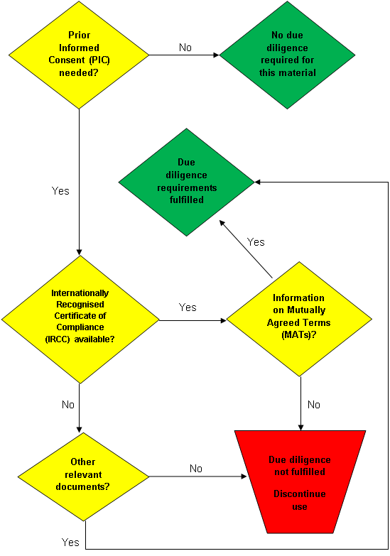
A
Due Diligence
A – Parties may implement international agreements which remove the need to obtain PIC (provided the agreements do not run counter to the objectives of the Protocol).
B – An IRCC comprising information on PIC and MATs can be used as evidence that the genetic resource has been accessed in accordance with the Protocol. This information can be used as part of the seek, keep and transfer procedure and must be kept for 20 years after the end of utilisation of the genetic resource.
C – If an IRCC is not yet available, the researcher must seek, keep and transfer other relevant documents related to the genetic resource.
B
C
Notes:
A – PIC of a provider country must be obtained before access to a GR is permitted, except in cases where international agreements remove this requirement.
C - If the relevant IRCC is not yet available, the user must seek, keep and transfer the following information and documents related to:
date and place of access of the genetic resources or traditional knowledge;
a description of the genetic resources or traditional knowledge utilised;
the source from which the genetic resources or traditional knowledge were directly obtained;
any subsequent users of the genetic resources or traditional knowledge;
details regarding the presence or absence of rights and obligations pertaining to access and benefit-sharing, including any rights and obligations relating to subsequent applications and commercialisation;
access permits, if applicable; and
any information comprised in the mutually agreed terms and benefit-sharing agreements.
If the above information is found to be insufficient or there are legal uncertainties to the access and utilisation of the genetic resources, a user shall obtain an access permit (or equivalent) and establish mutually agreed terms with the provider country. If this is not achieved, utilisation must be discontinued by the user.

Slide 16
Practical actions to be taken
Due diligence paperwork
  Ensure existing genetic resources are sufficiently documented as having been accessed before the date of entry into force of the Nagoya Protocol in the EU (i.e. before 14 October 2014).
    The Nagoya Protocol will not have retroactive effect in the EU. Hence, genetic resources shown to be accessed before the Nagoya Protocol will not be required to comply with the EU regulations which set out the Protocol in the EU.
Administrative preparations
  Take action to ensure administrative systems are in place to make certain any new genetic resources are documented in compliance with the Nagoya Protocol:
    Date and place of access
    Description of genetic resource utilised
    Direct source of genetic resource/traditional knowledge, any subsequent users
    ABS agreements, access permits, MATs, any rights or obligations related to ABS.
Internal procedures
  Carry out internal training to make employees aware of the Nagoya Protocol and the obligations of users of any genetic resources.
    Ensure employees understand that legal possession of a genetic resource does not necessarily imply that person has the right to do any work on or with that resource.
Origins
  Be aware of the origin of any genetic resources you might wish to use for the purposes of research and development.

Slide 17


Thank you
www.wilsongunn.com
Manchester Office: 0161 827 9400
Birmingham Office: 0121 236 1038
Liverpool Office: 0151 242 6703
Chesterfield Office: 01246 541 903
London Office: 0203 178 2767

