Slide 1







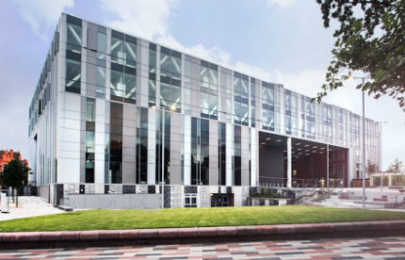
A SUMMARY OF UNIVERSITY FUNDING & EXPENDITURE 2016/17
Income increase of 1.7%. Expenditure increase of 3.3%.
How did we spend it?
Total Expenditure £188.5m
Where did the money come from? Total Income £195.1m
62.9%
10.1%
4.4%
0.7%
15.2%
2.8%
63% income from tuition fees
3.9%
Student Tuition Fees- £122.8m
Other teaching contracts and research training
support grants- £29.6m
Government funding grants- £19.7m
Funding for research projects- £5.5m
Income from residences, catering and conferences- £7.6m
Other Income- £8.6m
Income from investments and donations - £1.3m
19,848 student FTE’s
54% of income spent on staff costs
Surplus
A surplus is required in order to generate cash to fund day to day operations and to re-invest in facilities and equipment to ensure the long term sustainability of the University.
£6.5m Surplus for the year
£24.4m cash flow from operating activities
Cash flow generation is a key financial metric and 16/17 is the fourth year of generating over £20m of cash from operating activities.
These are extracts from the University of Salford audited financial accounts which are available here
£11.1m spent on new capital buildings and equipment

